Slide 1
The collatz Conjecture
The 3n + 1 Conjecture

Slide 2
"Mathematics may not be ready for such problems.“
- Paul Erdos
“This is an extraordinarily difficult problem, completely out of reach of present day mathematics.“
- Jeffrey Lagarias (2010)

Slide 3
The Conjecture
Take any positive n.
If n is even, divide it by 2
If n is odd, multiply it by 3 and add 1
Repeat the process indefinitely. The conjecture is that no matter what number you start with, you will always eventually reach 1.
https://en.wikipedia.org/wiki/Collatz_conjecture

Slide 4
Examples
1
2
→ 1
3
→ 10
→ 5
→ 16
→ 8
→ 4
→ 2
→ 1
7
→ 22
→ 11
→ 34
→ 17
→ 52
→ 26
→ 13
→ 40
→ 20
→ 10
→ 5

Slide 5

let’s code
Variations of the Collatz Problem

Slide 6

A desirable property of a program, is that no computational idea is expressed more than once.
To change an idea, you should only need to change one place in a program.
A program should be restructured to “make it so.”

Slide 7
Code 1
fun threeN 1 = 1
| threeN n = if n mod 2 = 0 then threeN (n div 2)
else (* odd *) threeN (3*n + 1);
threeN 7;

Slide 8
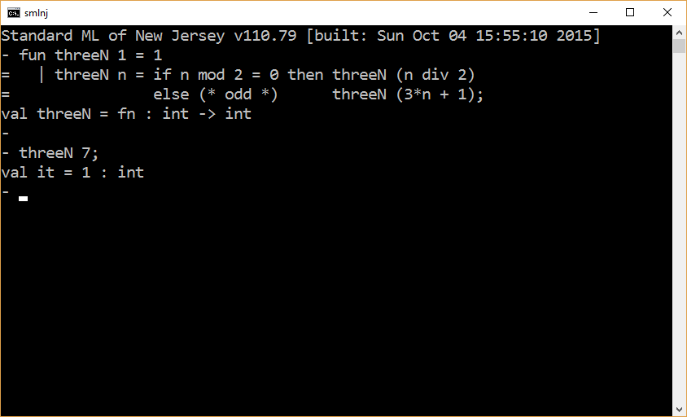

Slide 9
Code 2
fun isEven n = n mod 2 = 0;
fun threeN 1 = 1
| threeN n = if isEven n then threeN (n div 2)
else (* odd *) threeN (3*n + 1);
threeN 7;
Let us now factor out the call to threeN.

Slide 10
Code 3
fun isEven n = n mod 2 = 0;
fun threeN 1 = 1
| threeN n =
let
val nextN = if isEven n then n div 2
else (* odd *) (3*n + 1);
in
threeN nextN
end;
threeN 7;

Slide 11
Code 4
fun isEven n = n mod 2 = 0;
fun succ n = if isEven n then n div 2 else 3 * n + 1;
fun threeN 1 = 1
| threeN n = threeN (succ n);
threeN 7;

Slide 12
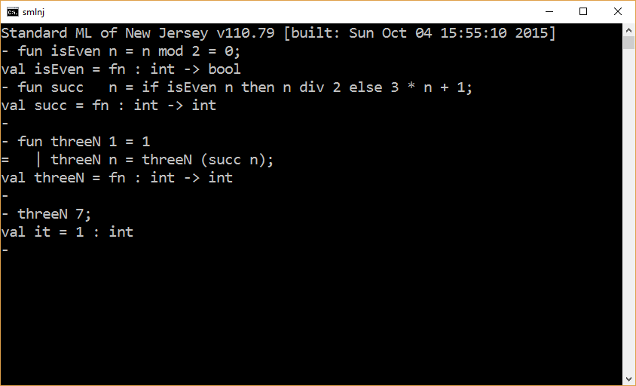

Slide 13
Extension
Logging intermediate values

Slide 14
Code 5
fun isEven n = n mod 2 = 0;
fun succ n = if isEven n then n div 2 else 3 * n + 1;
fun log n = (
print (“\n” ^ Int.toString n ^ “ -> ”);
n
);
fun threeN 1 = log 1
| threeN n = threeN ( succ (log n) );
threeN 7;

Slide 15
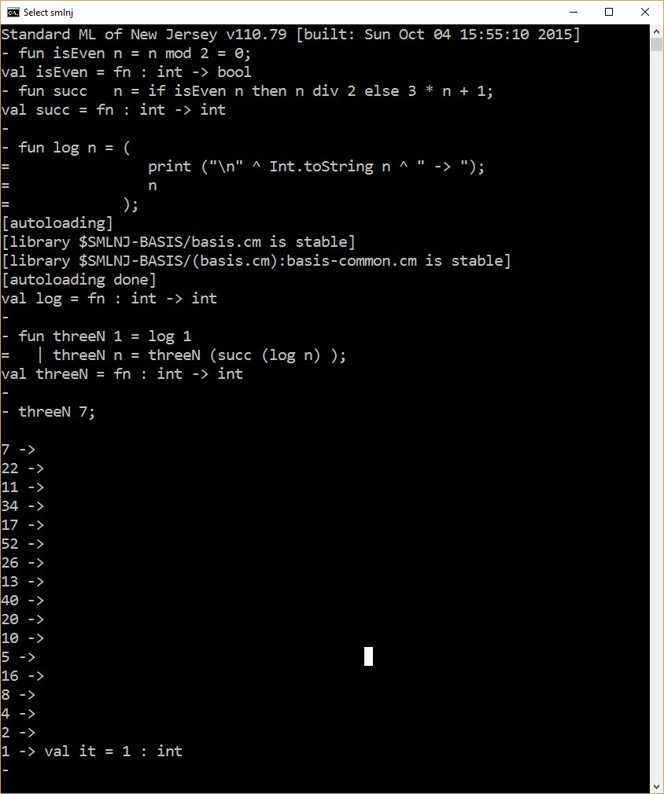
fix this
formatting

Slide 16
Code 5 - Fixed
fun isEven n = n mod 2 = 0;
fun succ n = if isEven n then n div 2 else 3 * n + 1;
fun log (n, sym) = (
print (“\n” ^ Int.toString n ^ sym);
n
);
val arrow = “->”;
val nl = “\n”;
fun threeN 1 = log (1,nl)
| threeN n = threeN (succ (log (n,arrow) ) );
threeN 7;

Slide 17
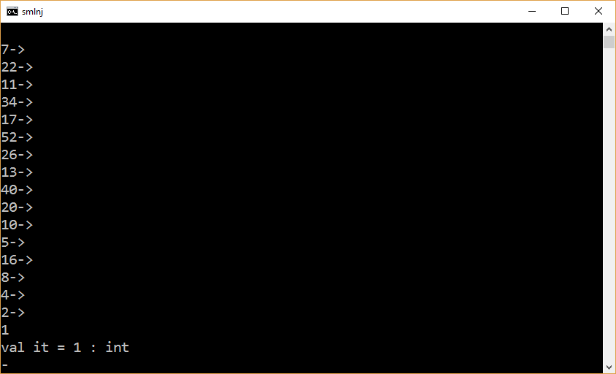

Slide 18
Code instrumentation
Tracking max value

Slide 19
Code 6a – Tracking Max (General and Base cases are asymmetric)
fun isEven n = n mod 2 = 0;
fun succ n = if isEven n then n div 2 else 3 * n + 1;
fun maxOf (v, w) = if v < w then w else v;
fun threeN n =
let
fun aux (1,max) = max
| aux (n,max) = aux( succ n, maxOf(n,max) )
in
aux( n, 1 )
end;
threeN 7;

Slide 20
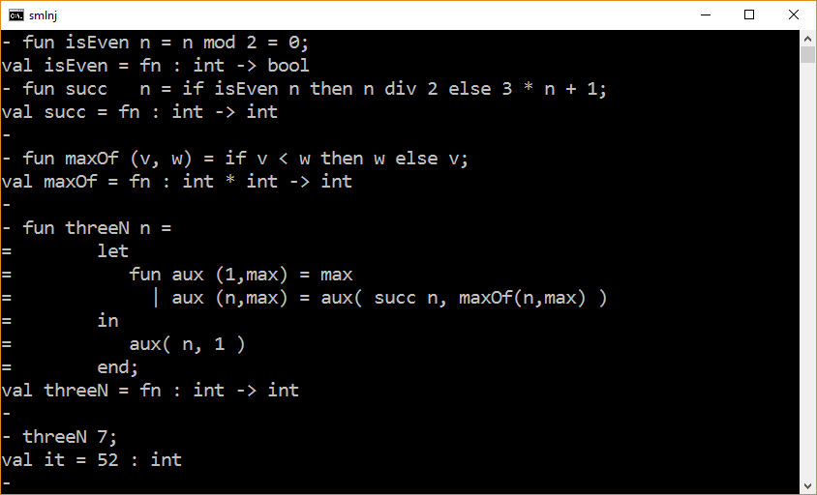

Slide 21
fun isEven n = n mod 2 = 0;
fun succ n = if isEven n then n div 2 else 3 * n + 1;
fun maxOf (v, w) = if v < w then w else v;
fun threeN n =
let
fun aux (1,max) = maxOf(1,max)
| aux (n,max) = aux( succ n, maxOf(n,max) )
in
aux( n, 0 )
end;
threeN 7;

Slide 22
fun isEven n = n mod 2 = 0;
fun succ n = if isEven n then n div 2 else 3 * n + 1;
fun maxOf (v, w) = if v < w then w else v;
fun threeN n =
let
fun aux (n,max) =
let
val newMax = maxOf(n,max)
in
if n = 1 then newMax
else aux( succ n, newMax )
end
in
aux( n, 0 )
end;
threeN 7;

Slide 23
fun isEven n = n mod 2 = 0;
fun succ n = if isEven n then n div 2 else 3 * n + 1;
fun maxOf (v, w) = if v < w then w else v;
fun threeN n =
let
fun aux (1,max,trackFn) = trackFn(1,max)
| aux (n,max,trackFn) = aux( succ n,
trackFn(n,max),
trackFn )
in
aux( n, 0, maxOf )
end;
threeN 7;

Slide 24
fun isEven n = n mod 2 = 0;
fun succ n = if isEven n then n div 2 else 3 * n + 1;
fun maxOf (v, w) = if v < w then w else v;
fun threeN n =
let
val trackFn = maxOf
fun aux (1,max) = trackFn(1,max)
| aux (n,max) = aux( succ n, trackFn(n,max) )
in
aux( n, 0 )
end;
threeN 7;

Slide 25
Guess what the max is for the call threeN 27?

Slide 26
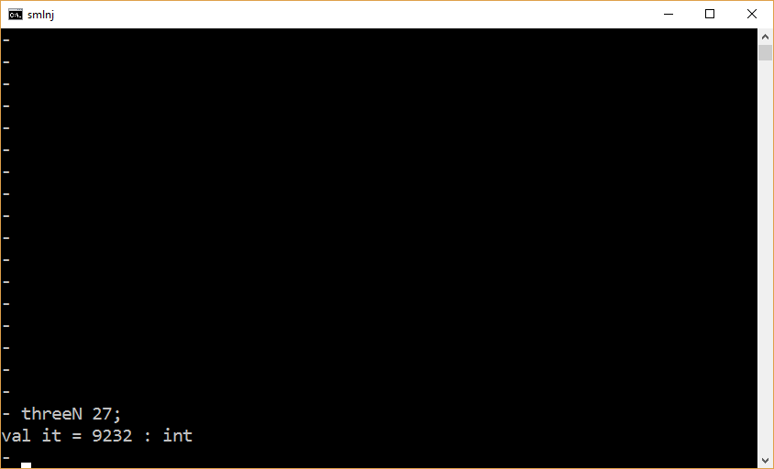

Slide 27
Code instrumentation
Tracking sequence length

Slide 28
Code 6 – Tracking Steps (i.e., Counting arrows)
fun isEven n = n mod 2 = 0;
fun succ n = if isEven n then n div 2 else 3 * n + 1;
fun threeN 1 = 0
| threeN n = 1 + threeN (succ n);
threeN 7;

Slide 29
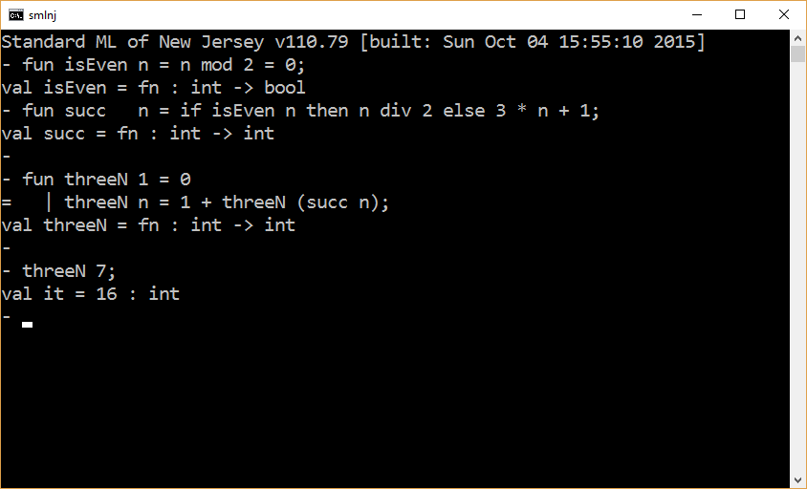

Slide 30
Code 6 – Tracking Steps revisited (a tail-recursive solution)
fun isEven n = n mod 2 = 0;
fun succ n = if isEven n then n div 2 else 3 * n + 1;
fun threeN n =
let
fun aux (1,steps) = steps
| aux (n,steps) = aux( succ n, steps + 1 );
in
aux (n, 0)
end;
threeN 7;

Slide 31
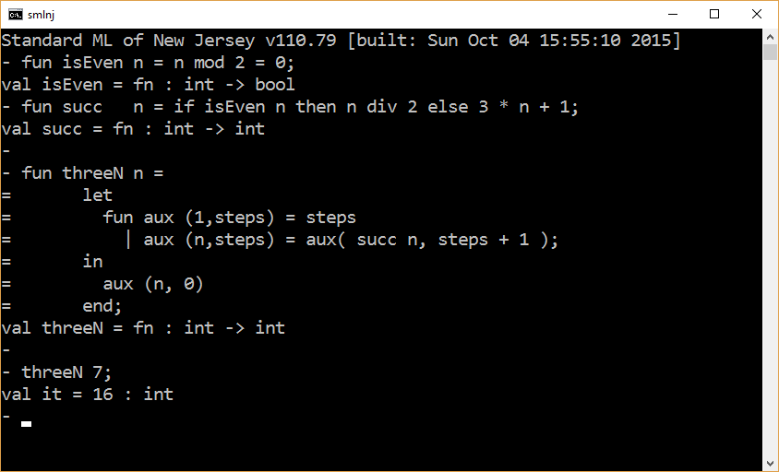

Slide 32
Code Instrumentation
Generalized tracking

Slide 33
Code 7 –Tracking Max
fun isEven n = n mod 2 = 0;
fun succ n = if isEven n then n div 2 else 3 * n + 1;
fun trackMax (n, max) = if n < max then max else n
fun threeN (n,track) =
let
fun aux (1,acc) = track(1,acc)
| aux (n,acc) = aux( succ n, track(n,acc) );
in
aux (n, 0)
end;
threeN (7,trackMax);

Slide 34
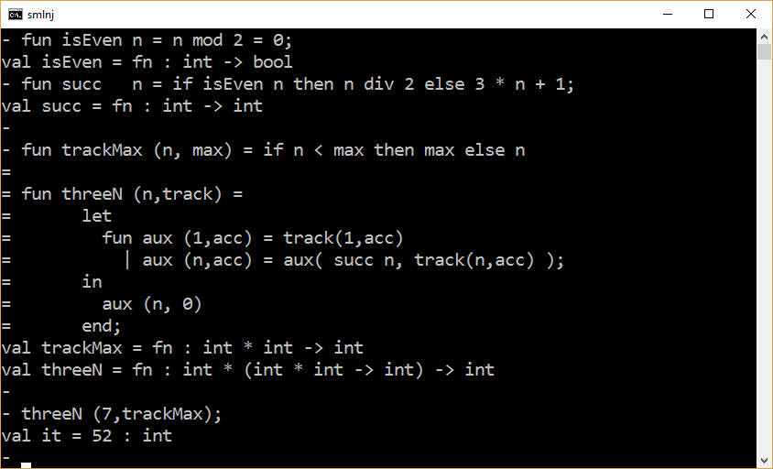

Slide 35
Code 8 –Tracking Steps
fun isEven n = n mod 2 = 0;
fun succ n = if isEven n then n div 2 else 3 * n + 1;
fun trackMax (n, max) = if n < max then max else n;
fun countSteps (n, count) = if n = 1 then count
else count + 1;
fun threeN (n,track) =
let
fun aux (1,acc) = track(1,acc)
| aux (n,acc) = aux( succ n, track(n,acc) );
in
aux (n, 0)
end;
threeN (7,countSteps);

Slide 36
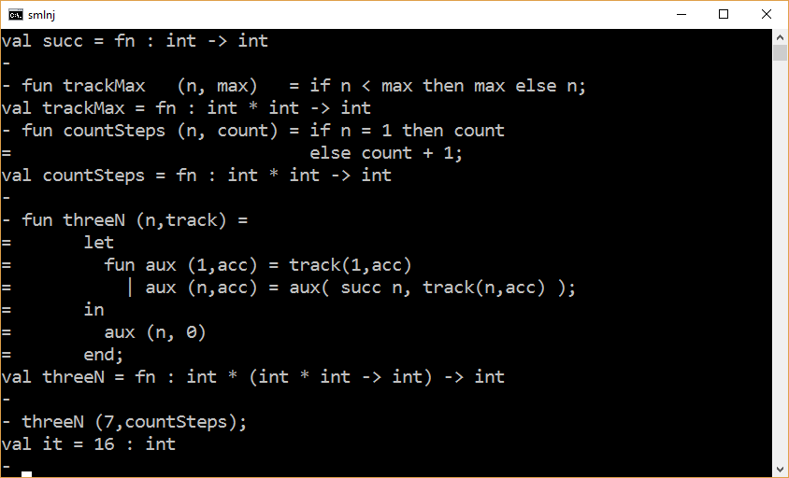

Slide 37
Validation Problem

Slide 38
Prove that the first 10,000 positive integers all reach 1.

Slide 39
fun validateRange n =
let
fun isEven n = n mod 2 = 0;
fun succ n = if isEven n then n div 2 else 3 * n + 1;
fun threeN 1 = 1
| threeN n = threeN (succ n);
fun checkTermination 1 = ()
| checkTermination n = (
threeN n;
checkTermination (n-1)
);
in
checkTermination n
end;
validateRange 10000;

Slide 40
fun validateRange n =
let
fun isEven n = n mod 2 = 0;
fun succ n = if isEven n then n div 2 else 3 * n + 1;
fun threeN 1 = 1
| threeN n = threeN (succ n);
fun checkTermination 1 = threeN 1
| checkTermination n = (
threeN n;
checkTermination (n-1)
);
in
checkTermination n
end;
validateRange 10000;

Slide 41
Property: The first 10,000 positive integers all reach 1.
Metric: Count the number of times you call the function threeN.

Slide 42
fun validateRange n =
let
fun isEven n = n mod 2 = 0;
fun succ n = if isEven n then n div 2 else 3 * n + 1;
(* counter is how many times prior to this call that
threeN has been called. *)
fun threeN (1,counter) = counter+1
| threeN (n,counter) = threeN (succ n, counter+1);
fun checkTermination (n,previousSum) =
let
val thisCount = threeN (n, 0);
val thisSum = previousSum + thisCount;
in
if n = 1 then thisSum
else checkTermination (n-1,thisSum)
end;
in
checkTermination (n, 0)
end;

Slide 43
Test Cases | Hand Computed Results
validateRange 1; | 1 (* threeN is called once *)
validateRange 2; | 3 (* previous sum + step count for 2 *)
validateRange 3; | 11 (* previous sum + step count for 3 *)
validateRange 4; | 14 (* 14 = 11 + 3 *)
validateRange 5; | 20
Remark. For a given n, counting calls to threeN is the same as counting how many numbers there are in a sequence.

Slide 44
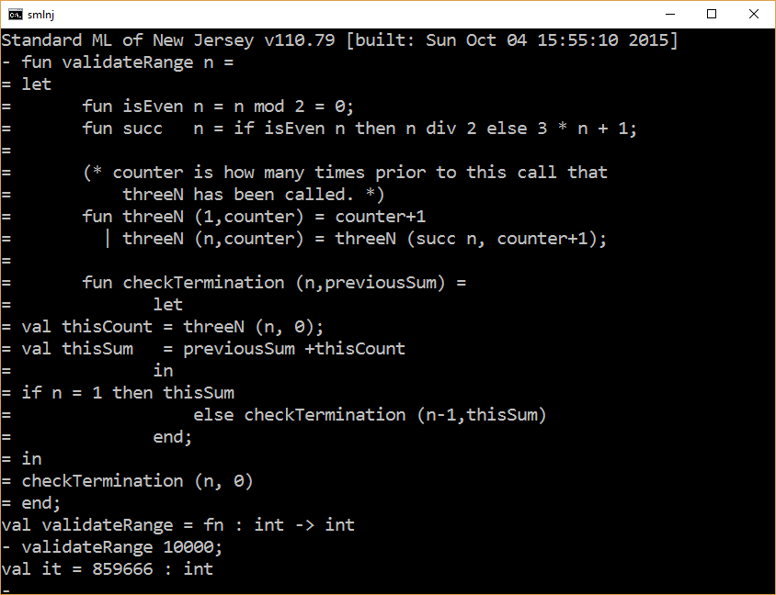

Slide 45
Now reduce the metric by a factor of 10 or more while still proving the property.

Slide 46
fun validateRange n =
let
fun isEven n = n mod 2 = 0;
fun succ n = if isEven n then n div 2 else 3 * n + 1;
(* counter is how many times prior to this call that
threeN has been called. *)
fun threeN (start, k, counter) =
if k = 1 orelse k < start then counter+1
else threeN (start, succ k, counter+1);
fun checkTermination (k, n, currentSum) =
if k <= n then
let
val thisCount = threeN (k, k, 0);
val nextSum = currentSum + thisCount;
in
checkTermination (k+1, n, nextSum)
end
else currentSum;
in
checkTermination (1, n, 0)
end;

Slide 47
Test Cases | Hand Computed Results | Optimized Sequences Inspected (we are interested in how many numbers are encountered, and we stop early when we can)
validateRange 1; | 0 | 1
validateRange 2; | 3 | 1, 2 → 1
validateRange 3; | 10 | 1, 2 → 1, 3 → 10 → 5 → 16 → 8 → 4 → 2
validateRange 4; | 12 | 1, 2 → 1, 3 → 10 → 5 → 16 → 8 → 4 → 2, 4 → 2
validateRange 5; | 16 | 1, 2 → 1, 3 → 10 → 5 → 16 → 8 → 4 → 2, 4 → 2, 5 → 16 → 8 → 4

Slide 48
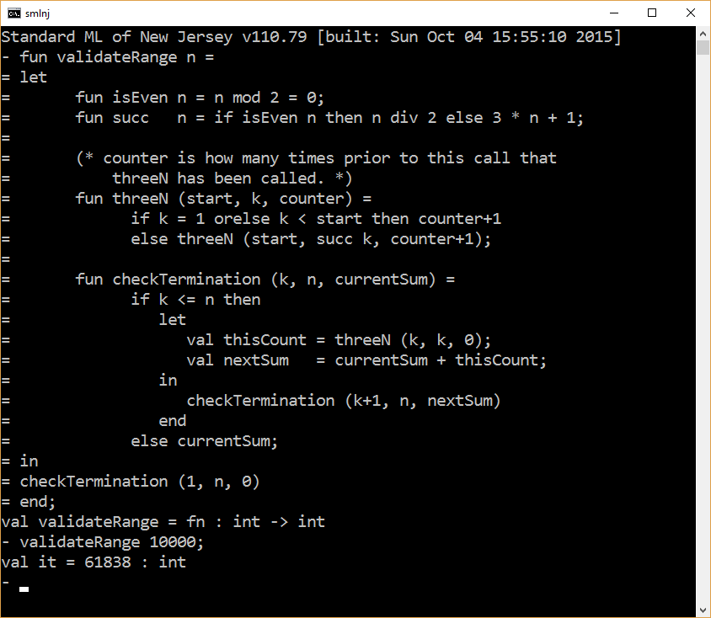

Slide 49

It is possible to optimize further?

Slide 50
The end

